Slide 1


Modeling EHR with the openEHR approach
An exploratory study in China
By: Mennatullah Mahmoud 18101713

Slide 2

Introduction
OpenEHR is an open standard maintained by the openEHR Foundation, which endeavors to convert health data from a physical form into an electronic form and ensures universal interoperability among electronic data in all forms.
The openEHR approach has three major pillars:
Reference Model (RM)
Archetype Model (AM)
Terminologies

Slide 3
OpenEHR
RM
AM
Terminologies
Logical Structure the defines the basic structures and attributes needed to express EHR data instances
Formal and semantic artifacts that facilitate collecting, storing, retrieving, representing, communicating and analyzing clinical data
Yes, terminology-neutral approach allows referring to external terminologies in archetypes, such as SNOMED CT, ICD, LOINC

Slide 4

OpenEHR Approach Expansion
Europe
Australia
Germany, Norway, UK, Sweeden, Denmark, etc.
Asia
America
Japan, Indonesia, China, etc.
Brazil

Slide 5
Implementation
Editing archetypes based on domain concepts
Organizing domain concepts
Reviewing archetypes
Normalizing data elements
Searching crossponding archetypes
Collecting data requirements

Slide 6

01
Collecting data requirements

Slide 7
Key accomplishments
Sorces of data requirements
Compining data fields
Organizing domain concepts
Relational tables were collected as the data elements required in an EHR. Tables were designed to support specific business logics
Two existing EHR systems have been interpreted. First is implemented in more than 1000 hospitals and the other is developed as national project
Categories used to group the tables first so that it contains all the involved data elements, and then organize these data elements into domain concepts

Slide 8
02
Normalizing data elements

Slide 9
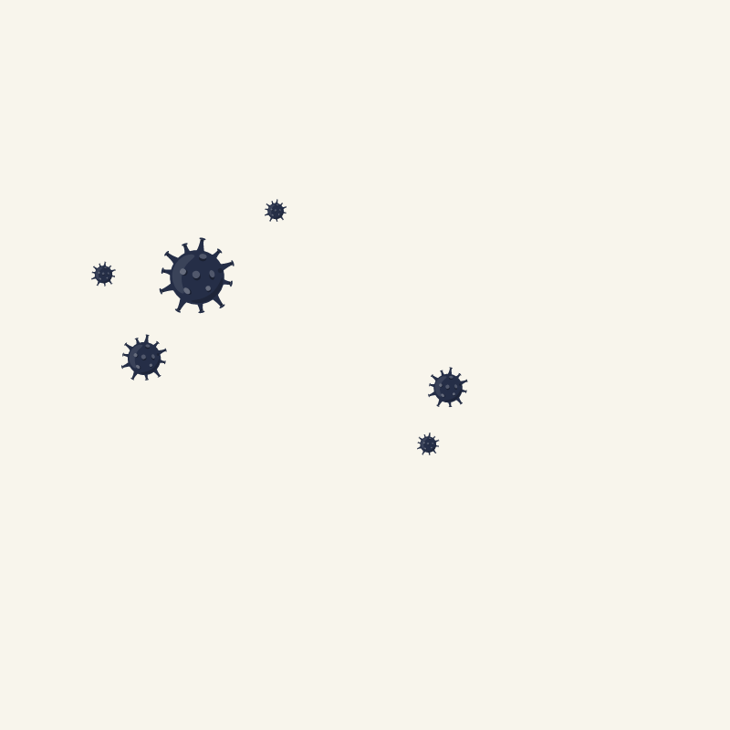
Key numbers
WS 363-2011
WS 364-2011
Health data element dictionary
Classification and coding for value domain of health data element
WS 445-2014
Basic dataset of electronic medical record

Slide 10
Contents of this template
The rules for the normalization process are listed as follows:
If an EHR data element and a standard data element have the same semantics -> EHR data element uses the definition of the standard data element (naming, coded value, value domain, etc.).
An If multiple EHR data elements correspond to one standard data element -> these EHR data elements and the corresponding standard data element will both be reserved.
If an EHR data element corresponds to multiple standard data elements and the semantics of the EHR data element can be represented entirely by these standard data elements -> EHR data element is replaced by the standard data elements.

Slide 11
03
Organizing domain concepts

Slide 12
OpenEHR
Patient demographics
Clincal Pattern
Non-clinical Pattern
The concepts include patient information, address, and organization.
Problem-solving logic that represents the cycle of clinical information flow is used to organize the concepts.
Four types of “Instruction, Action, Evaluation, and Observation”.
Following concepts can be organized: admission, discharge, and transfer

Slide 13
04
Searching corresponding archetypes

Slide 14
Corresponding existing archetypes were retrieved based on three kinds of relationships:
A First, the concept and the existing archetype have the same semantics, e.g., the concept “diagnosis” and the existing archetype “openEHREHR-EVALUATION.problem_d-iagnosis.v1”.
Second, the semantics of the concept is one of the particular subsets of the existing archetype semantics, e.g., the concept “operation request” and the existing archetype “openEHR-EHRINSTRUCTI-ON.request.v0”.
Third, the semantics of the concept is more general than the existing archetype’s, e.g., the concept “physical sign” and the existing archetype “openEHR-EHR-OBSERVATION.body_temperature.v2”.
The CKM was adopted as the source to search corresponding existing archetypes for domain concepts.

Slide 15
05
Editing Archetypes

Slide 16
Domain experts would execute five kinds of operations for archetype reuse when the clinical concept has matched archetypes in CKM:
If the existing archetype covered all the data elements and nothing needed to be changed, then the existing archetype was reused directly.
The existing archetype covered all data elements, but the meta-data required to be refined, then a revision operation was executed, including translation, extending value sets and description
If the existing archetype covered only a portion of the data elements, three potential modification choices were provided. The specialization operation was executed when the clinical concept could be expressed by specializing the existing archetypes to make the semantics more elaborate and narrower, which required changing the identification information of the archetype. The extension operation was executed when some compatible modifications to the existing archetype were needed for expressing the clinical concept. A new version was created when some incompatible modifications to the existing archetype were needed, which changed the version information.

Slide 17
Result of searching | Category of covered | Operation
 | Covered by archetype completely. | Used directly
 | Need to modify description, translation, and extend the value sets. | Revision
Existing corresponding archetype | Need to specialize the archetype and add more constraint. | Specialization
 | Need to add new items to the definition section and maintain compatibility. | Extension
 | Modification that makes the archetype incompatible with the original archetype. | New version
No corresponding archetype | No covered | New

Slide 18
06
Reviewing Archetypes

Slide 19

The review focused on two aspects of the defined archetypes: domain concepts and information representation. For the domain concepts review, the archetypes were represented as mind-maps initially for facilitating domain experts' review. Then, the meta-data and organizational structure of the concept was evaluated, including naming, description and terminology constraints, and the relationships between the data items.

Slide 20
Results

Slide 21
Sixty four archetypes were developed to represent all requirements of a complete EHR dataset. 59 (91%) archetypes could be found in Clinical Knowledge Manager (CKM), of which 35 could be reused directly without change, and 23 required further development including two revisions, two new versions, 18 extensions and one specialization. Meanwhile, 6 (9%) archetypes were newly developed. The legacy data of the EHR system in hospitals could be integrated into the CDR developed with these archetypes successfully.

Slide 22
The searched results of domain concepts
Demographics | openEHR-DEMOGRAPHIC-ADDRESS.address.v1 openEHR-DEMOGRAPHIC-ADDRESS.electronic_communication.v1 openEHR-DEMOGRAPHIC-PERSON.person.v1 openEHR-DEMOGRAPHIC-PARTY_IDENTITY.person_name.v1 openEHR-DEMOGRAPHIC-ORGANISATION.organisation.v1 openEHR-DEMOGRAPHIC-CLUSTER.person_identifier-provider.v1 openEHR-DEMOGRAPHIC-CLUSTER.person_identifier.v1 openEHR-DEMOGRAPHIC-PERSON.person-patient.v1 openEHR-DEMOGRAPHIC-ITEM_TREE.person_details.v1
Immunization summary | openEHR-EHR-EVALUATION.Immunization_summary.v1
Social summary | openEHR-EHR-EVALUATION.social_summary.v1
Pregnancy history document | openEHR-EHR-COMPOSITION.pregnancy_summary.v1
Pregnancy history | openEHR-EHR-EVALUATION.pregnancy_summary.v0 openEHR-EHR-CLUSTER.document_entry_metadata.v1
Vaccination history | openEHR-EHR-EVALUATION.vaccination_summary.v1
Health history | openEHR-EHR-EVALUATION.health_risk.v1
Family history document | openEHR-EHR-COMPOSITION.family_history.v1
Family history | openEHR-EHR-EVALUATION.family_history.v2 openEHR-EHR-EVALUATION.exclusion-family_history.v1 openEHR-EHR-CLUSTER.person_name.v1
Progress note document | openEHR-EHR-COMPOSITION.progress_note.v1
Progress note | openEHR-EHR-EVALUATION.absence.v1 openEHR-EHR-CLUSTER.distribution.v1 openEHR-EHR-EVALUATION.exclusion.v1 openEHR-EHR-OBSERVATION.progress_note.v1
Admission | openEHR-EHR-ADMIN_ENTRY.admission.v1 openEHR-EHR-CLUSTER.address.v1 openEHR-EHR-CLUSTER.organisation.v0 openEHR-EHR-CLUSTER.education.v1 openEHR-EHR-CLUSTER.household.v0 openEHR-EHR-CLUSTER.employment.v0
Discharge | openEHR-EHR-ADMIN_ENTRY.discharge_admin_info.v3
Blood matching | openEHR-EHR-OBSERVATION.blood_match.v1
Transfusion request | openEHR-EHR-INSTRUCTION.transfusion.v0
Transfusion process | openEHR-EHR-ACTION.transfusion.v1
Medication request | openEHR-EHR-INSTRUCTION.medication_order.v1 openEHR-EHR-CLUSTER.medication_ingredients.v1 openEHR-EHR-CLUSTER.medication_admin.v1 openEHR-EHR-CLUSTER.timing.v1 openEHR-EHR-ACTION.medication.v0
Lab test request | openEHR-EHR-INSTRUCTION.request-lab_test.v1 openEHR-EHR-CLUSTER.specimen.v0
Lab test process | openEHR-EHR-INSTRUCTION.lab_test.v1
Lab test result | openEHR-EHR-OBSERVATION.lab_test.v1
Newborn | openEHR-EHR-OBSERVATION.apgar.v1
Height | openEHR-EHR-OBSERVATION.height.v1
Weight | openEHR-EHR-OBSERVATION.body_weight.v2
Body surface area | openEHR-EHR-OBSERVATION.body_surface_area.v0
BMI | openEHR-EHR-OBSERVATION.body_mass_index.v2
Temperature | openEHR-EHR-OBSERVATION.body_temperature.v2
Consultation | openEHR-EHR-INSTRUCTION.request.v0
Order request | openEHR-EHR-INSTRUCTION.request.v0
Order process | openEHR-EHR-ACTION.procedure.v1
Operation request | openEHR-EHR-INSTRUCTION.request-procedure.v0
Examination request | openEHR-EHR-OBSERVATION.imaging_exam.v0
Examination process | openEHR-EHR-ACTION.imaging_exam.v0
Diagnose | openEHR-EHR-EVALUATION.problem_diagnosis.v1

Slide 23
Thanks for your attention!

